Slide 1
AUTHENTICATION BASED HYBRID CRYPTOSYSYTEM

Slide 2
OBJECTIVES
To design an hybrid cryptosystem to support secure communication
and authentication services.
To study the existing secure systems and its workflow.

Slide 3
ABSTRACT
The project runs various phase such as key generation, encryption, decryption, sign generation and sign verification
Our crypto system applies both RSA and linear RSA to support blind sign authentication

Slide 4
INTRODUCTION
Cryptography is a technique to achieve confidentiality of messages. . Cryptography can be defined as techniques that cipher data, depending on specific algorithms that make the data unreadable to the human eye unless decrypted by algorithms that are predefined by the sender. Nowadays, however, the privacy of individuals and organizations is provided through cryptography at a high level, making sure that information sent is secure in a way that the authorized receiver can access this information. In order to achieve this level of security, various algorithms and methods have been developed. Billions of people around the globe use cryptography on a daily basis to protect data and information, although most do not know that they are using it.

Slide 5
RELATED WORKS
Nаmе | Аuthоr | Description
[1] Hybrid IT architecture by gene-based cryptomata (HITAGC) for lightweight security services, | Viswanathan P. | The proposed algorithm makes use of four large prime numbers which increases the complexity of the system as compared to traditional RSA algorithm which is based on only two large prime numbers. In the proposed Enhanced and Secured RSA Key Generation Scheme (ESRKGS)[8],
[2] An efficient public key secure scheme for cloud and IOT security, Jnl Computer communication | Senthil Kumar M, | According to the National Institute of Standard and Technology (NIST), the security level of RSA is safe when it is N-bit modulus ≥2048 bits. Because of this, the processing time to generate asymmetric keys also increases. Taking this into account, an efficient and non-shareable Public Key Exponent Secure Scheme (ENPKESS) [6] is proposed by using a non-linear Diophantine equation to have high security against side-channel attacks like timing attacks.
[3] An Enhanced and Secured RSA Key Generation Scheme (ESRKGS) | M. Thangavel, P. Varalakshmi, | In the proposed Enhanced and Secured RSA Key Generation Scheme (ESRKGS)[8], the public component n is the product of two large prime numbers but the values of Encryption € and Decryption (D) keys are based on the product of four large prime numbers (N) making the system highly secured.
[4] Intelligent cryptography approach for secure distributed big data storage in cloud computing | Yibin Li. | The proposed scheme is entitled Security-Aware Efficient Distributed Storage (SA-EDS)[9] model, which is mainly supported by our proposed algorithms, including Alternative Data Distribution (AD2) Algorithm, Secure Efficient Data Distributions(SED2) Algorithm and Efficient Data Conflation (EDCon) Algorithm.
[5] An Enhanced and Secured RSA Key Generation Scheme (ESRKGS) | Thangavel.M | The proposed algorithm makes use of four large prime numbers which increases the complexity of the system as compared to traditional RSA algorithm which is based on only two large prime numbers. In the proposed Enhanced and Secured RSA Key Generation Scheme (ESRKGS)[10], the public component n is the product of two large prime numbers but the values of Encryption € and Decryption (D) keys are based on the product of four large prime numbers (N) making the system highly secured. With the existing factorization techniques, it is possible only to find the primes p and q.

Slide 6
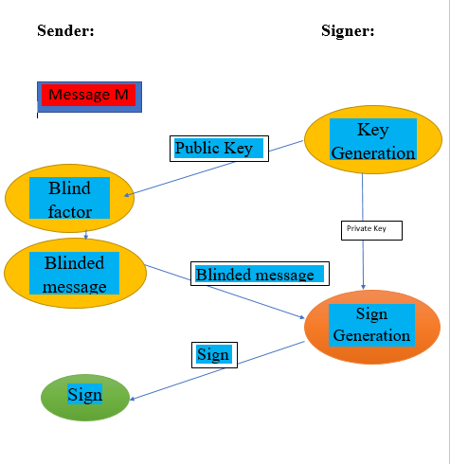
PROPOSED METHODOLOGY AND ARCHITECTURE

Slide 7
MODULE DESCRIPTION
Key generation : Key generation is the process of generating keys in cryptography. A key is used to encrypt and decrypt whatever data is being encrypted/decrypted. A device or program used to generate keys is called a key generator or key gen.
Encryption : encryption is the process of encoding information. This process converts the original representation of the information, known as plaintext, into an alternative form known as cipher text. Ideally, only authorized parties can decipher a cipher text back to plaintext and access the original information.
Decryption : The conversion of encrypted data into its original form is called Decryption. It is generally a reverse process of encryption. It decodes the encrypted information so that an authorized user can only decrypt the data because decryption requires a secret key or password.

Slide 8
Sign generation : Sign generation is the process of creating a digital signature for a message or document.
Sign verification : Sign verification is the process of verifying the authenticity and integrity of a digital signature

Slide 9
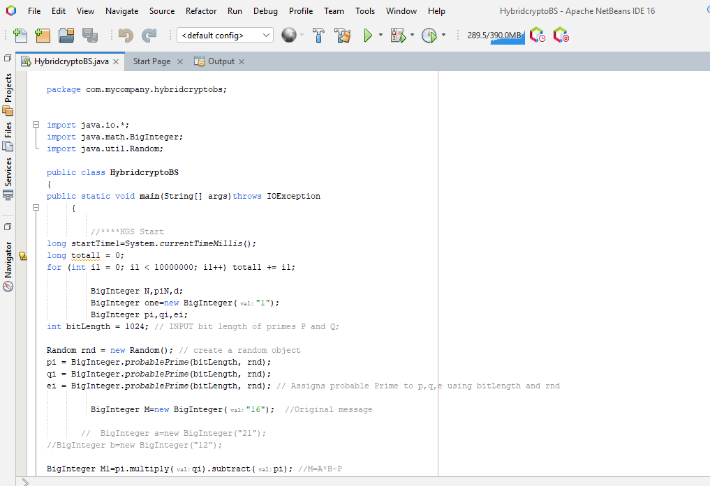

Slide 10
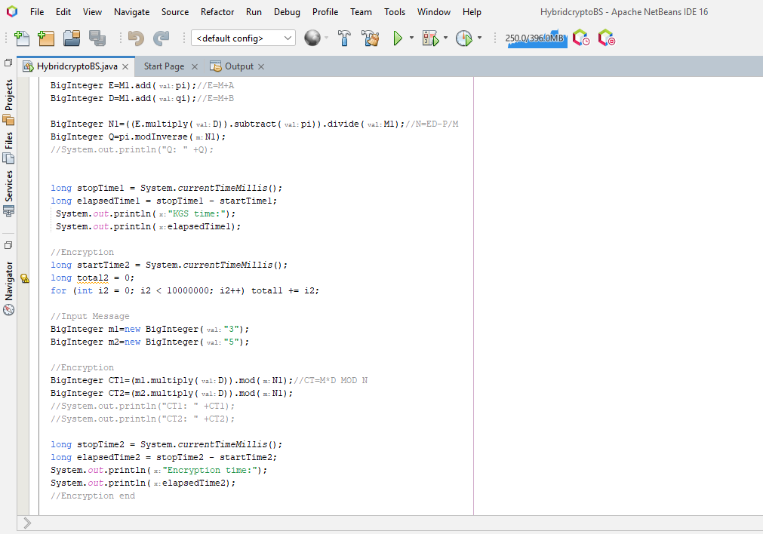

Slide 11
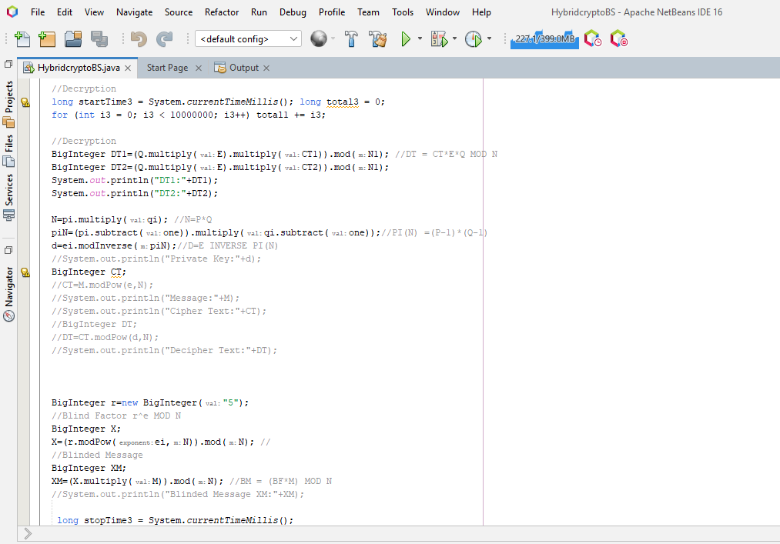

Slide 12
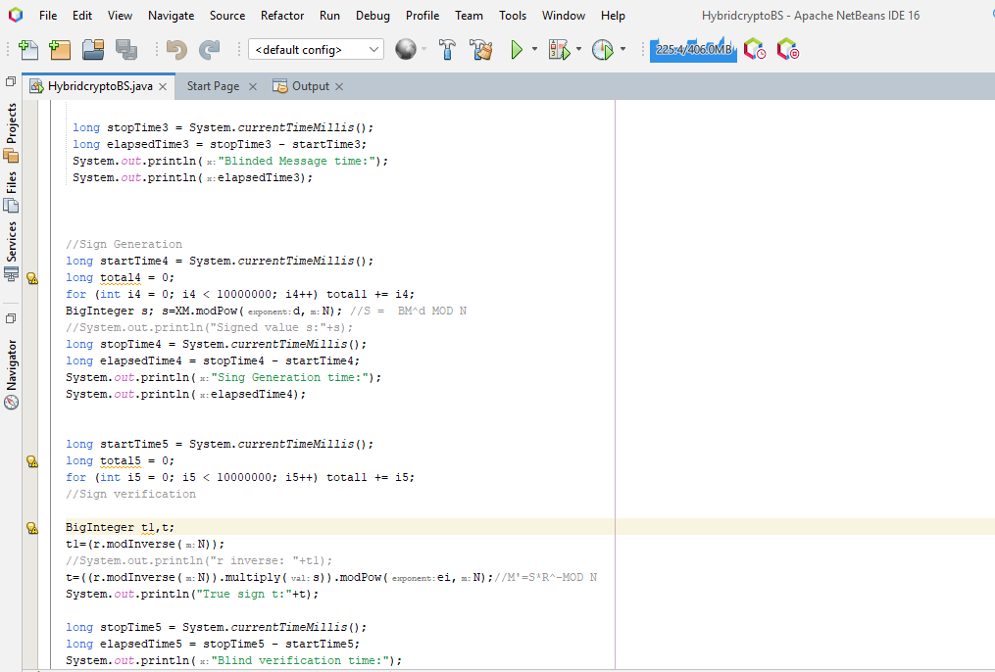
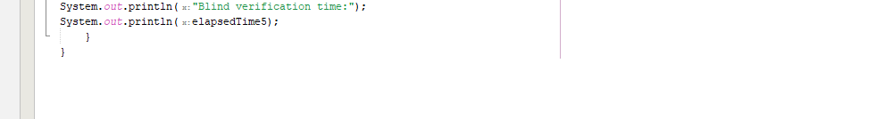

Slide 13
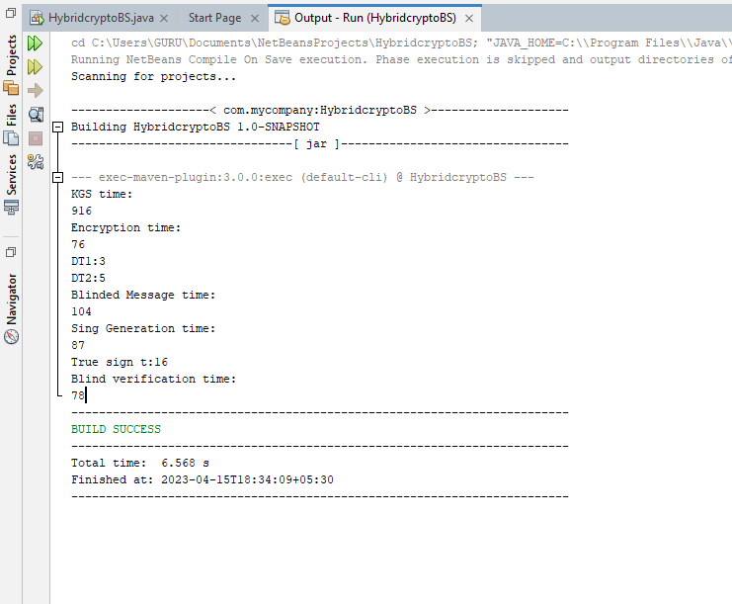
OUTPUT:

Slide 14
CONCLUSION
Blind Signature is a form of digital signature in which the content of a message is disguised (blinded) before it is signed. . Blind signatures are typically employed in privacy-related protocols where the signer and message author are different parties. Blind signatures can be used to authenticate the source of messages. When ownership of a blind signature secret key is bound to a specific user, a valid signature shows that the message was sent by that user. If a message is digitally signed, any change in the message will invalidate the signature. Furthermore, there is no efficient way to modify a message and its signature to produce a new message with a valid signature, because this is still considered to be computationally infeasible by most cryptographic hash functions.

Slide 15
REFERENCE
Wang W, Lee K, Murray D (2017) A global generic architecture for the future Internet of Things. Serv Oriented Comput Appl 11:329– 344. https://doi.org/10.1007/s117617-
0213-1 2. Li Y, Gai K, Qiu L et al (2016) Intelligent cryptography approach for secure distributed big data storage in cloud computing. Inf Sci (Ny). https://doi.org/10.1016/j.ins.2016.09.005 3.
Esposito C, Castiglione A, Martini B, Choo KKR (2016) Cloud manufacturing: security, privacy, and forensic concerns. IEEE Cloud Comput.
https://doi.org/10.1109/MCC.2016.79 4.

Slide 16
Modic J, Trapero R, Taha A, Luna J (2016) Novel efficient techniques for real-time cloud. Comput Secur 62:1–18. https://doi.org/10.1016/j.cose.2016.06.003 5.
Sun L, Dong H, Khadeer F (2014) Cloud service selection: state-ofthe-art and future research directions. J Netw Comput Appl 45:134– 150. https://doi.org/10.1016/j.jnca.2014.07.019

Slide 17
THANK YOU

